Slide 1
Scatter plot error

Slide 2
CHECK MISSING
#check for missing valunique(WHOk$IND_CODE)
# to see is there missingsum(is.na(WHOk$HWF_0001))# to see percent missingmean(is.na(WHOk$HWF_0001)) * 100
# check misingeness before wider WHOk %>% filter(IND_CODE == "HWF_0001", DIM_1_CODE == "SEX_BTSX") %>%
summarise( total_records = n(), missing_values = sum(is.na(VALUE_NUMERIC)), percent_missing = mean(is.na(VALUE_NUMERIC)) * 100 )

Slide 3
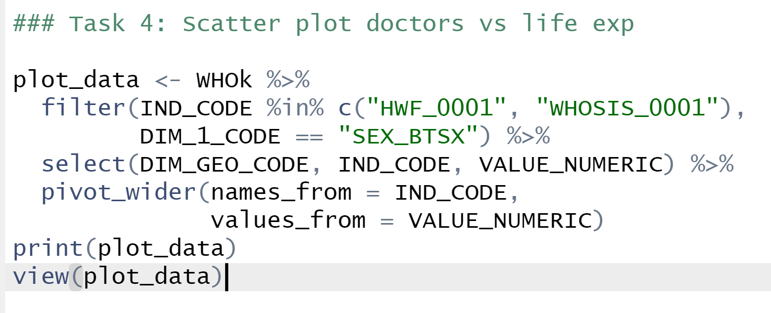

Slide 4
